Slide 1
Basic Python
A fast track 2 x ½ Day course to introduce essential components of the Python programming language and its interactive computational environment Jupyter.
Python is becoming the world’s most popular coding language

Slide 2
Repository of Course Notes
All course materials are available from Github repository
https://github.com/dbl007/bpc
Acknowledgement:
https://jakevdp.github.io/WhirlwindTourOfPython/
https://www.blog.pythonlibrary.org/2018/07/25/jupyter-notebook-101-preview-chapters/

Slide 3
Course Objective
Learn the basic syntax of Python language, familiar with various popular Python packages and run Python scripts.
Foundation training for AI and Machine Learning courses which uses Python

Slide 4
Teaching Plan
Hands-on Jupyter jupyter-notebook-101-preview-chapters
Get comfortable with Python by typing code. Compare/contrast Python with C.
Use the A Whirlwind Tour of Python notebooks to learn Python’s essential syntax and semantics, built-in data types and structures, function definitions, control flow statements, and more, using Python 3 syntax.
Real world example of using Python for web scraping
Explore Machine Learning resource on https://colab.research.google.com

Slide 5
Microsoft Azure Notebook
Get Started…..
Goto > https://notebooks.azure.com/
Sign in with your NP credential.
Create a new library from my Github repository https://github.com/dbl007/npbpc.git

Slide 6
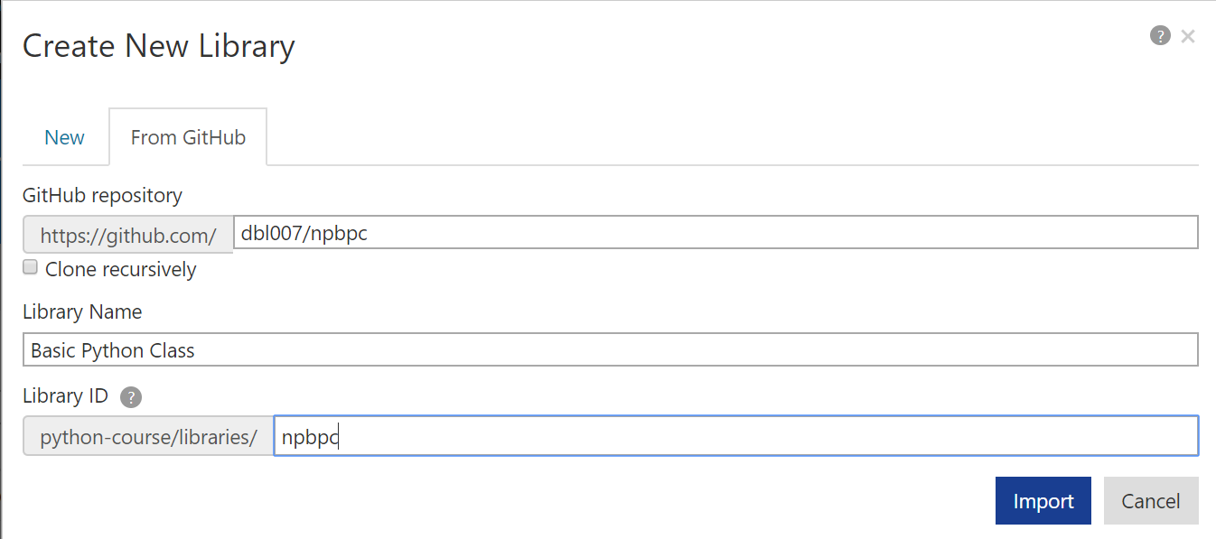

Slide 7
Summary, Feedback, Thank you.

